Slide 2

We built this
Francisco Munoz
Amr Thameen
Masha Malygina
Kylie Gao

Slide 3
“Can I have your recipe for chocolate chip cookies?”
“I have to find the link, but it’s not vegan, so you got to substitute the butter for coconut oil and…”

Slide 4
THE PROBLEM “I need a place to store my recipes – I can’t find and share recipes I’ve liked and personalize them”
Food recipe content is more popular than ever, but there’s no way to store, personalize or share it:
AllRecipes.com receives 69.2M site visits per month (from similarweb, Oct ‘18 data)
The top 10 cooking magazines have circulation of >20M (Nielsen ‘17)
https://www.cision.com/us/2017/05/top-10-cooking-magazines-circulation/

Slide 5
Personal recipe content is still mostly physical…
HOW YOU STORE YOUR CONTENT…
HOW YOU STORE YOUR RECIPES…
NOTES
PHOTOS
IDEAS
MUSIC

Slide 6
OUR SOLUTION Fork it allows you to discover, share, store and fork your recipes with other users. Like a GitHub for recipes.
We’re building a food community to share home cooking experiences, creating a new way to discover, share, personalize and store food experiences

Slide 7
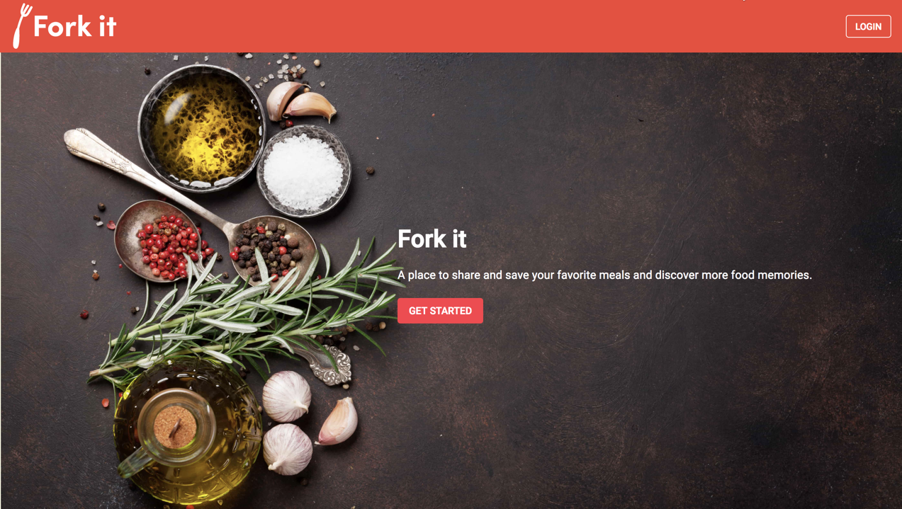

Slide 8
Our Tech Stack
APPLICATION TECH STACK
API DATA / SERVICES USED
MATERIAL-UI
GOOGLE O-AUTH
REACT
REDUX
EDAMAM RECIPES API
EXPRESS
AXIOS
SEQUELIZE
WEB SPEECH
POSTGRES SQL

Slide 9

GET FORKING!
forkit-io.herokuapp.com

